Slide 1

CONCRETE SOFTWARE SOLUTIONS PVT. LTD.
A leading Digital Marketing Firm In India

Slide 2
DIGITAL MARETING PLAN
Search Engine Marketing
Social Media Marketing
PPC
Google Display Networking
Bulk SMS
Email Marketing
Text / Picture Greeting

Slide 3
Search Engine Marketing
On-Page Optimization
Off-Page Optimization
Website Analysis
Keyword Analysis
Link Building
Classified Ads
Meta Tag Creation
Content Optimization
Image Optimization
Site Navigation Structure
And many more activities…..
Local Listing Marketing
Blogging
Article Submission
Press Release Submission
And many more activities…

Slide 4
SMO
Social Micro Blogging Websites
FACEBOOK
TWITTER
LINKED IN
YOUTUBE
We Can advertise our products and services on these websites through Text Message, Attractive Image and Video clips .
You have lot of other website option including above websites.

Slide 5
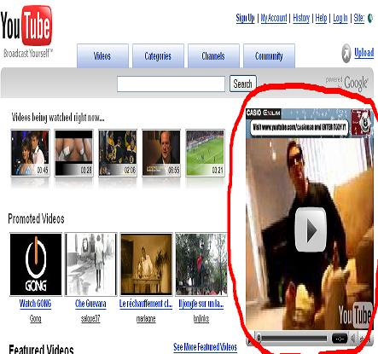
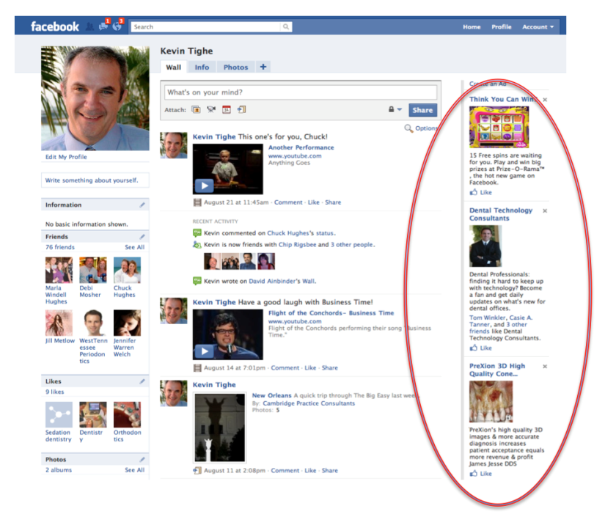
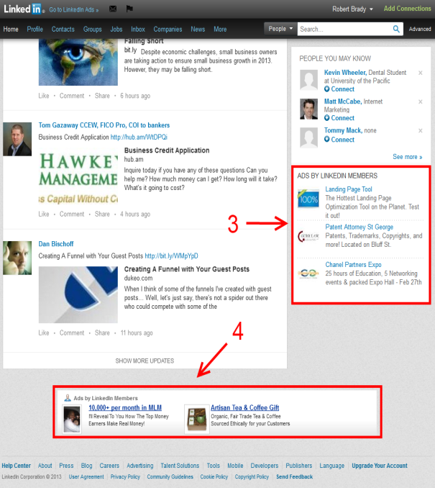
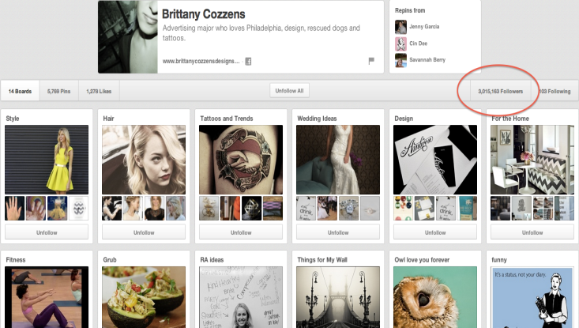
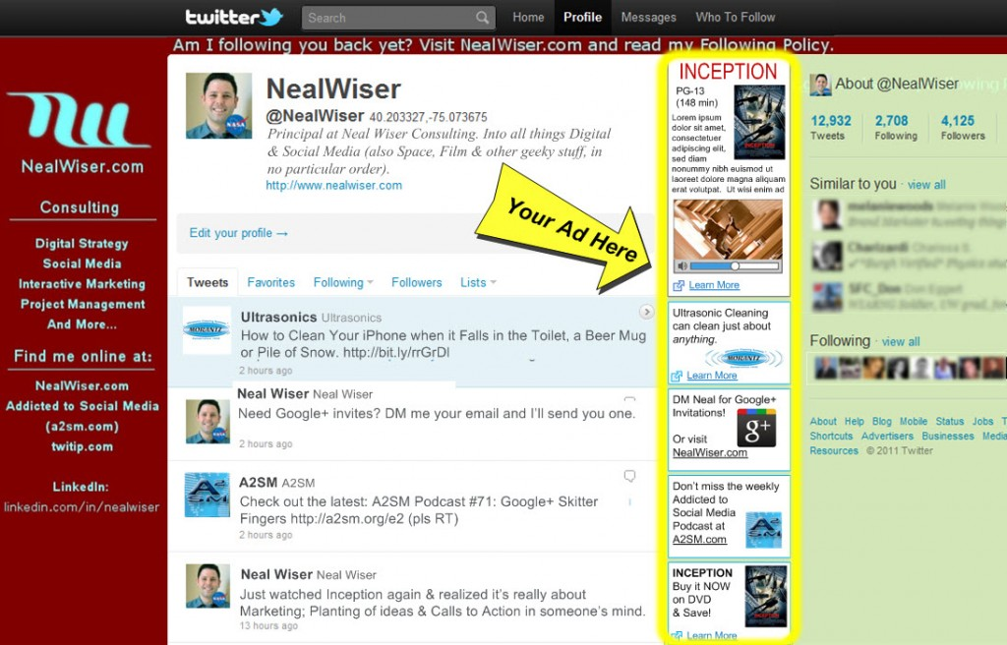
Some Ads Examples on SMO Websites

Slide 6
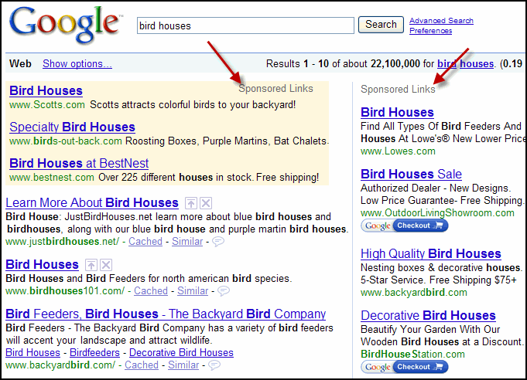
PPC – Pay Per Click
Google Sponsored Listing
or
Google Ad words Program
Mostly Search Engines offers such kind of advertising listing

Slide 7
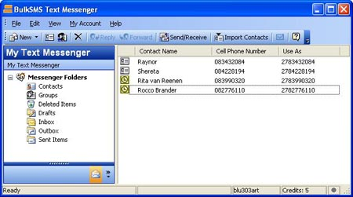
Bulk SMS
Send Bulk SMS text messages about Company’s products and Services to 166 countries worldwide from your PC, Web, or Application

Slide 8

Email Marketing
Text Mail
Graphic Mail
Video Mail

Slide 9



Text / Picture Greeting
Create attractive greeting cards of Festivals, Birthday or other occasions by using Images of company Name , Products and Services

Slide 10
Google Display Networking
Advertiser Ads
Google Display networking Campaign
The Google Display Network lets you place ads on a variety of news sites, blogs and other niche sites across the internet
to reach more potential customers.
Ads on Website 1
Ads on Website 2
Ads on Website 3
Ads on Website 4
Ads on Website 5

Slide 11



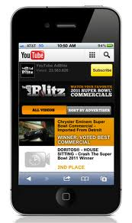
Google Display Network Ads Format
Text Ads on websites
Image Ads on websites
Video Ads on websites
Ads on Mobile Websites

Slide 12
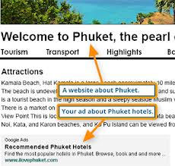
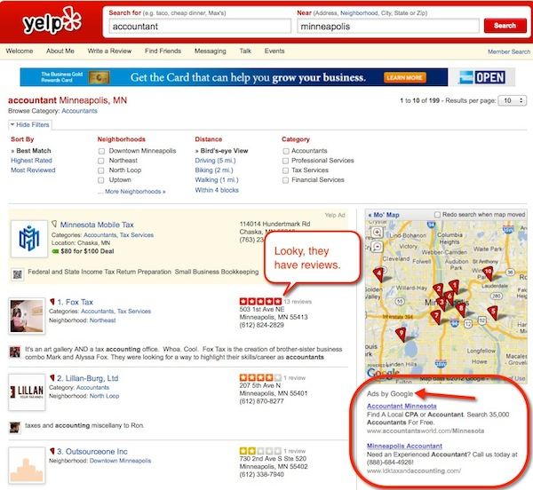
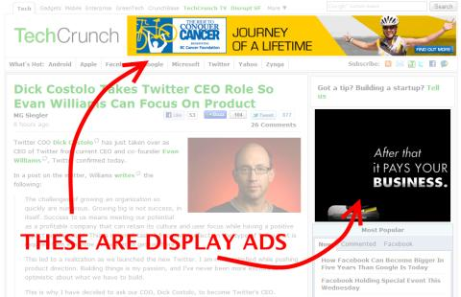
Google Display Network Ads Examples

Slide 13
Targeting Tools in Google Display Network
Contextual Targeting
Placement Targeting
Remarketing
Interest Categories
Show ads on sites related to your keywords - Keyword Contextual Targeting delivers relevant messages to users based on the type of content they consume.
Show ads on specific websites that you choose -Choose a whole site or just the specific pages where you want your ad to appear.
Bring good customers back -People who have already visited your site are shown your ads as they browse other sites on the Google Display Network.
Show ads based on user interests - Travel ads for travel fans: that's the simple goal of interest categories.

Slide 14
Targeting Tools in Google Display Network
Topic Targeting
Geographic and Language Targeting
Demographic Targeting
Other Tools
Show ads on pages about specific subjects
Topic targeting is a close cousin to interest categories, but based on sites rather than audience.
Show ads where your customers are located
Geographic and language targeting let you display your ads by language, region, even postal code.
Show ads to users based on their age and gender
If your typical customer skews toward a particular age range or gender, you can use demographic targeting to show your ads specifically to those people who are most likely interested in your business.
Above-the-Fold Advertising
Ad Scheduling
Frequency Capping
Exclusions

Slide 15
DIGITAL MARETING SERVICES COST
Search Engine Marketing – Rs. 5000 / m
Social Media Marketing – Rs. 6000/m
PPC
Rs. 12000 / m
Google Display Networking – Rs. 20,000 /m
Bulk SMS – Rs. 8000/m
Email Marketing – Rs. 6000/m
Text / Picture Greeting –
Rs 5000/m

Slide 16
CONTACT US
CONCRETE SOFTWARE SOLUTION PVT. LTD.
C – 210, Govindpuram
GHAZIABAD, UP - 201013
Phone: 0120 – 2764421
Mobile: 09582102222
Email: sales@cssinfotech.in
Website: http://www.cssinfotech.in

